Slide 1
Git
And GitHub
By Arjun Raj

Slide 2
Git
GitHub
Git is a distributed version-control system for tracking changes in any set of files, originally designed for coordinating work among programmers cooperating on source code during software development.
GitHub, Inc. is a subsidiary of Microsoft which provides hosting for software development and version control using Git.

Slide 3
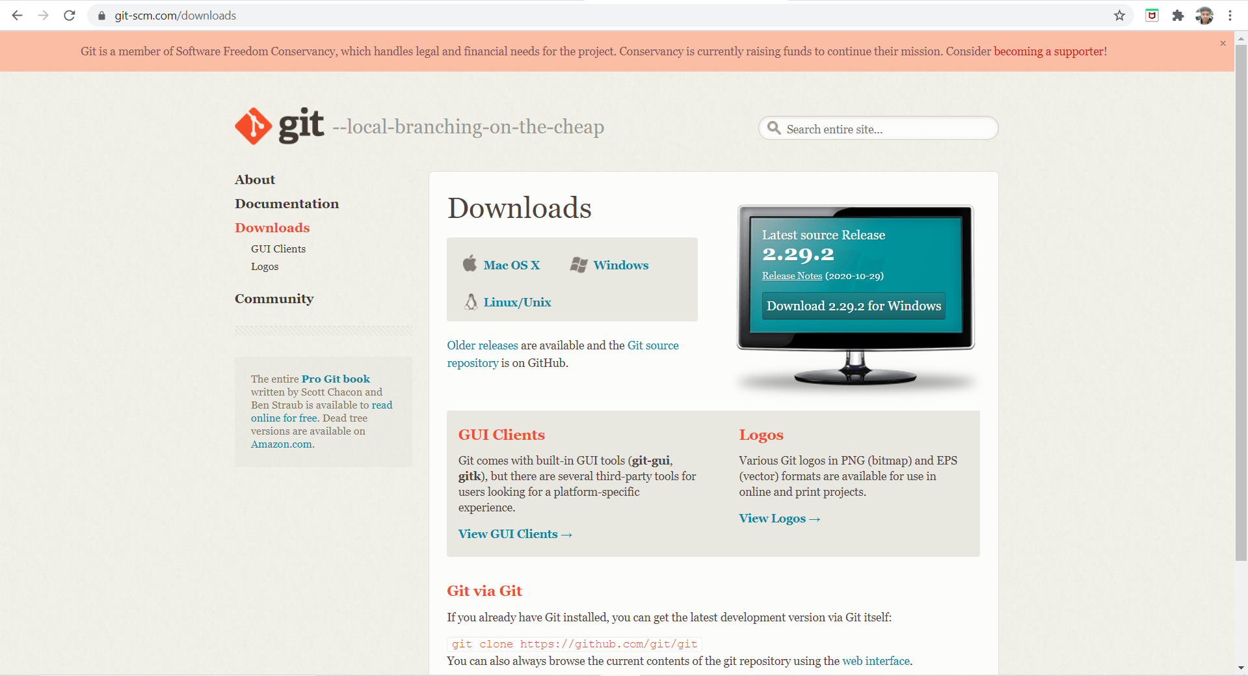
Go to git.com and download git

Slide 4
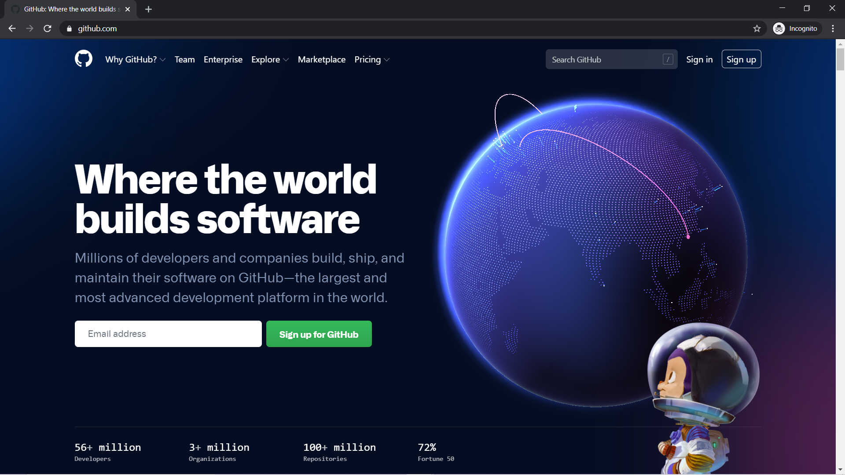
Go to github.com

Slide 5
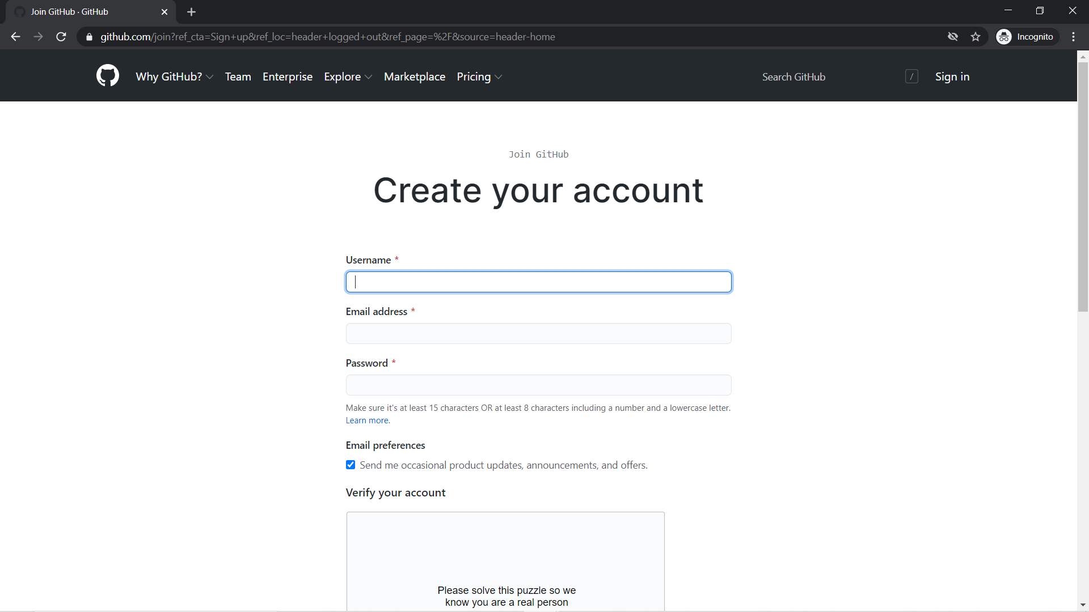
Sign Up for new account

Slide 6
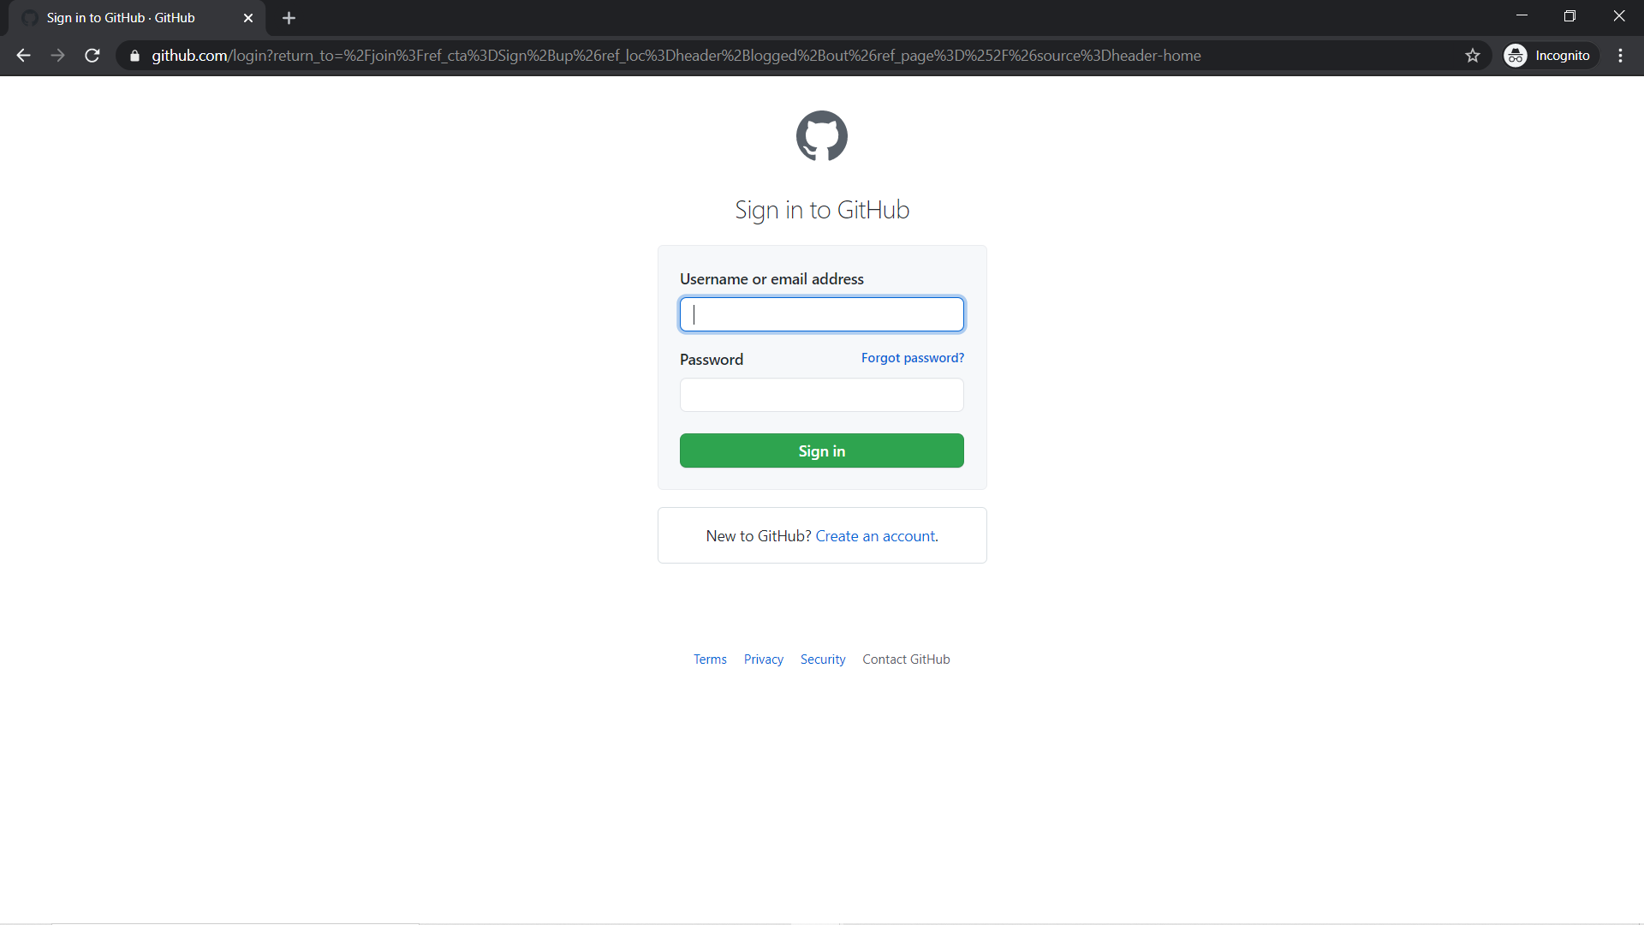
Github- Sign in page

Slide 7
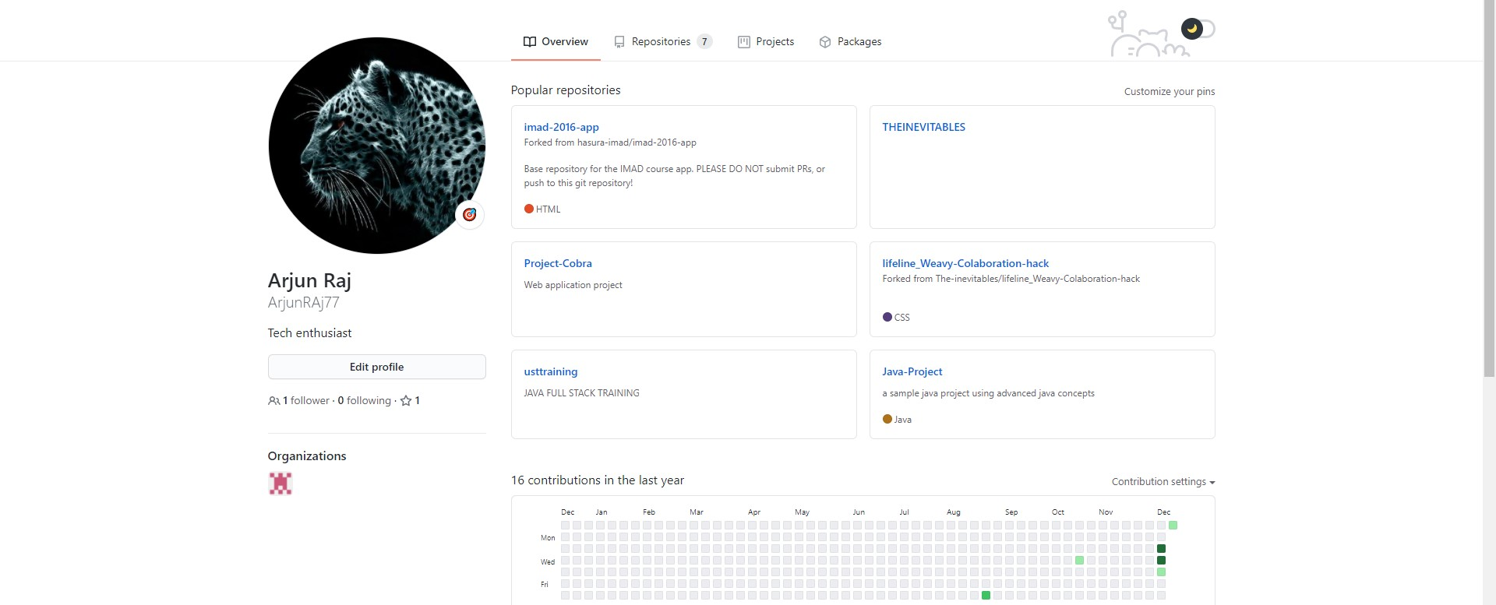
Github Profile

Slide 8
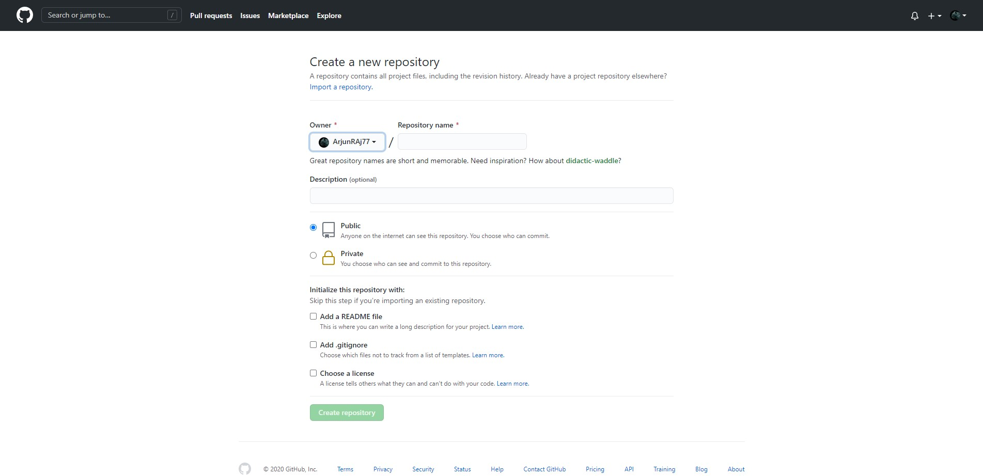
Creating new repository

Slide 9
Create a new repository through the CMD
git init
git add .
git commit –m “Initial commit”
git remote add origin <git url>
git push -u origin master

Slide 10
Thank You!

